Slide 1
Introduction to Neural Networks

Slide 2
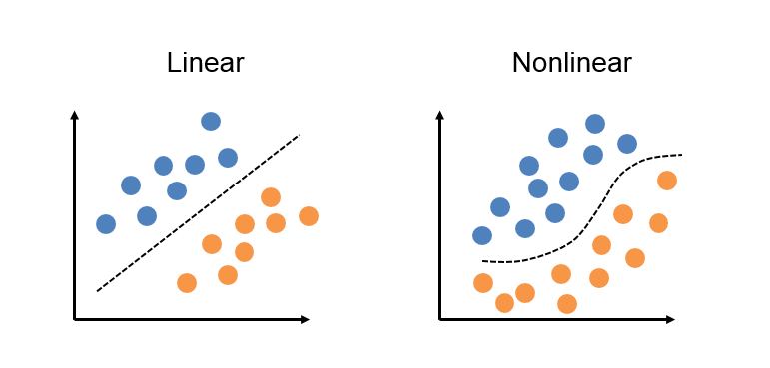
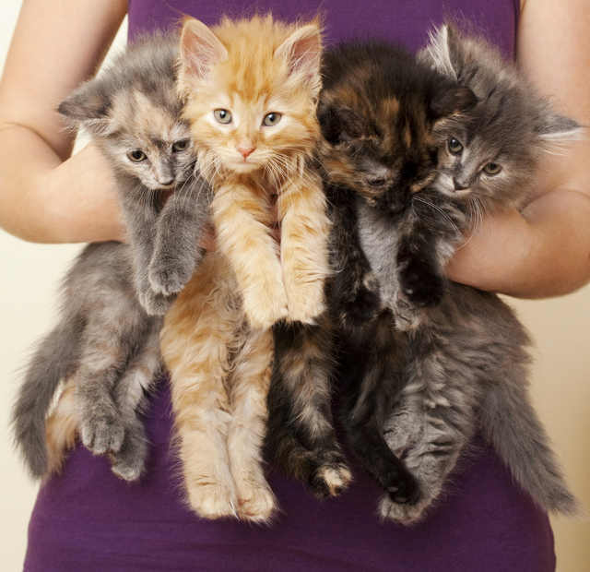
Model Representation: Linear and Nonlinear Classifiers
???

Slide 3
Some non-linear classifiers
Quadratic discriminant classifier
Decision trees
Random forest
K-nearest neighbours
….
Today’s hottest: Neural networks! (aka Multi-layer perceptron)

Slide 4
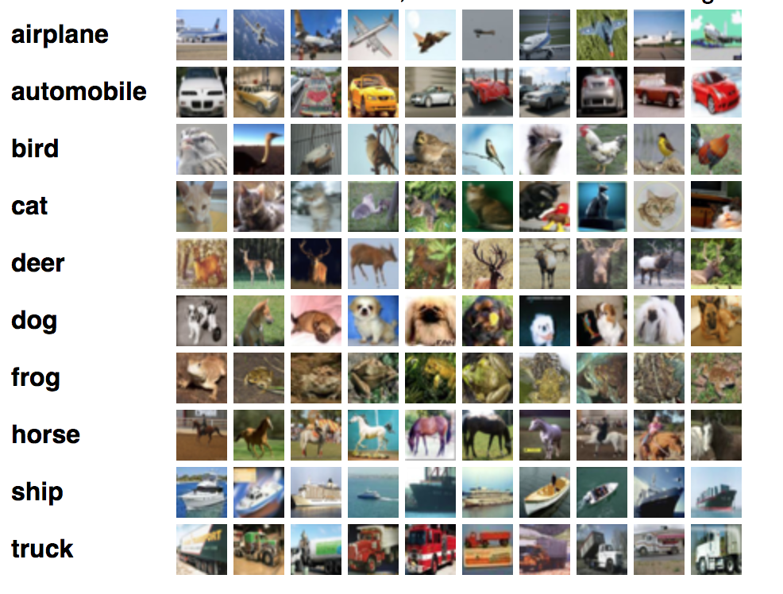
CIFAR-10
32x32 pixels
10 classes
50000 train
10000 test
https://www.cs.toronto.edu/~kriz/cifar.html

Slide 5
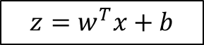
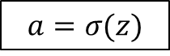
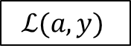
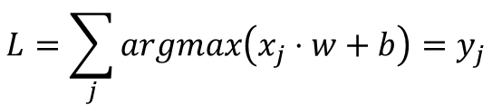
Linear to non-linear classifier
input features
x
weights (params)
w
bias
b
non-linear activation
function
Loss function

Slide 6
Do you know any example where activation function was used?

Slide 7
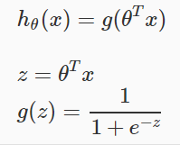
Do you know any example where activation function was used?
Logistic regression!

Slide 8
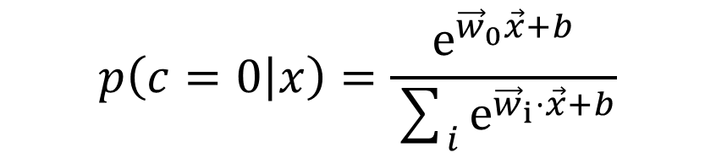
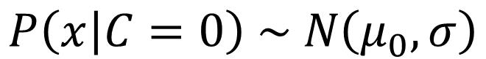
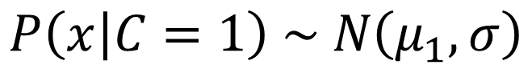
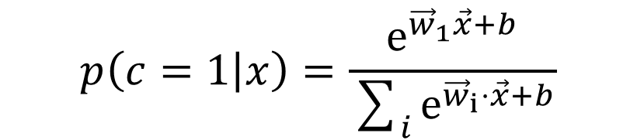
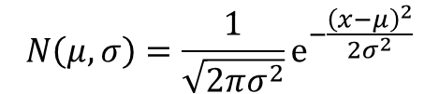
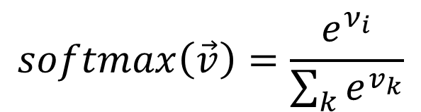
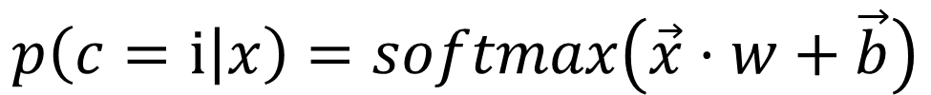
Softmax: a better loss function
Softmax classifier provides “probabilities” for each class.

Slide 9
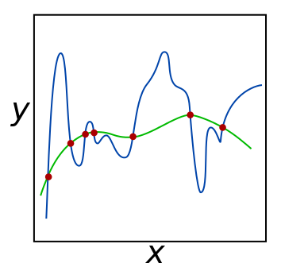
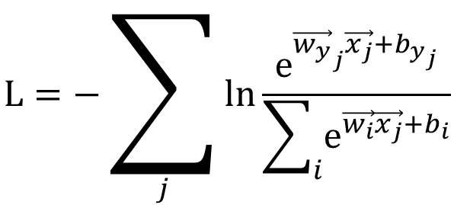
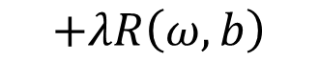
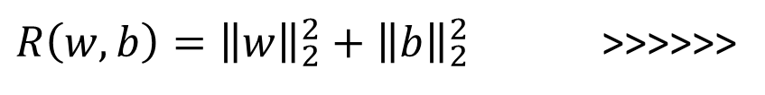
Regularization

Slide 10
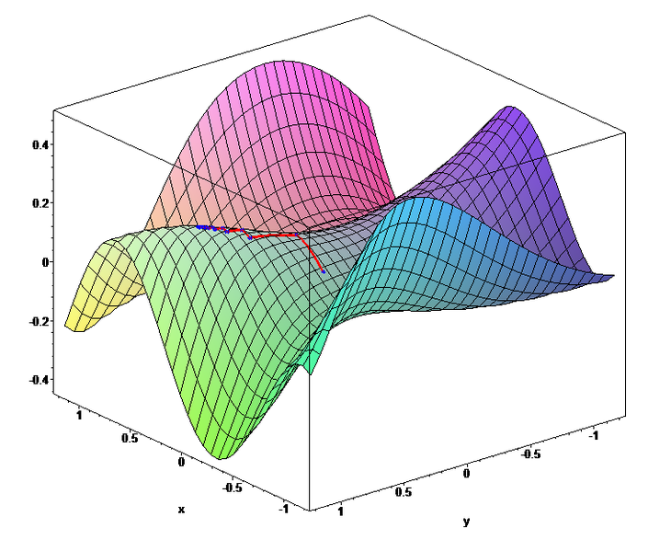
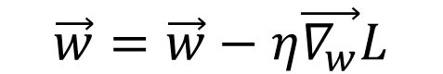
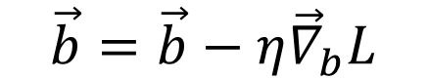
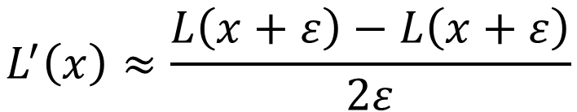
Gradient descent

Slide 11
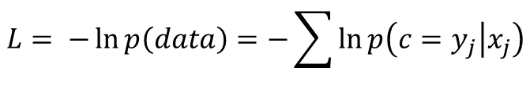
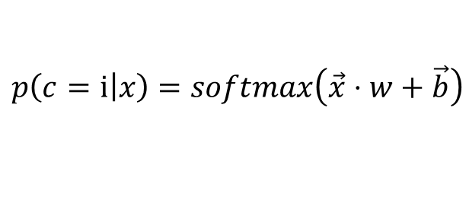
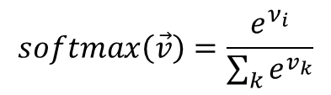
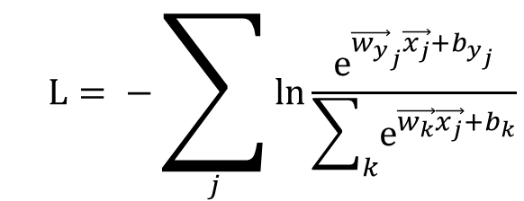
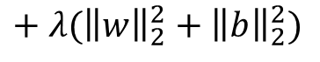
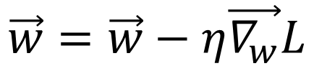
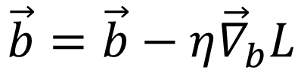
Putting everything together

Slide 12
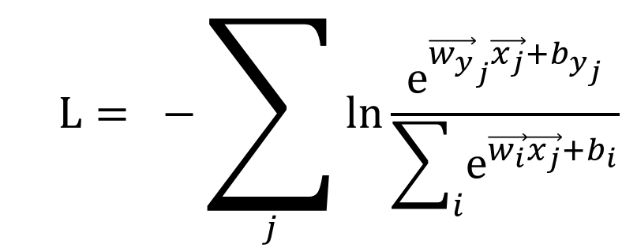
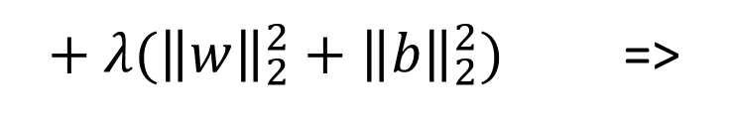
Analytic gradient

Slide 13
Stochastic Gradient Descent (SGD)
The gradient from a mini-batch is a good approximation of the gradient of the full objective => much faster convergence can be achieved in practice by evaluating the mini-batch gradients to perform more frequent parameter updates.
Stochastic Gradient Descent (SGD or also on-line GD): extreme case where mini-batch contains only a single example.
it is usually assumed that mini-batches are used; the size of the mini-batch is a hyperparameter but it is not very common to cross-validate it
based on memory constraints (if any), or set to some value, e.g. 32, 64 or 128.

Slide 14
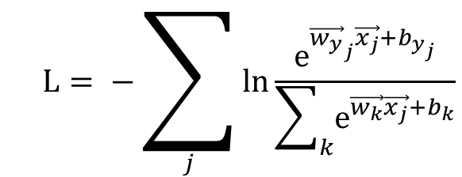
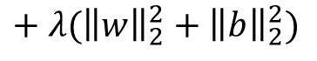
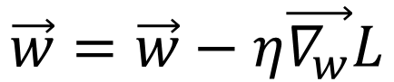
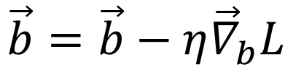
Can we improve it?

Slide 15



Find better features
samples
features
labels

Slide 16
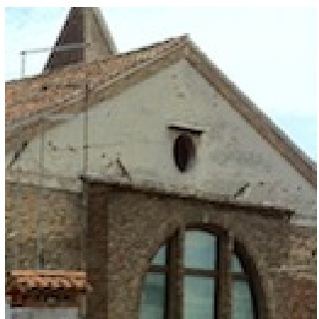
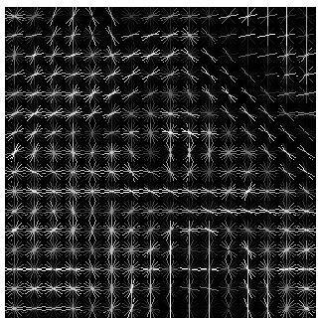
Example: Histogram of oriented gradients - HOG

Slide 17
Changing architecture: adding non-linear layers
X
w
softmax

Slide 18
Changing architecture: adding non-linear layers
Non-linear function
w¹
w²
w³
Softmax
X

Slide 19
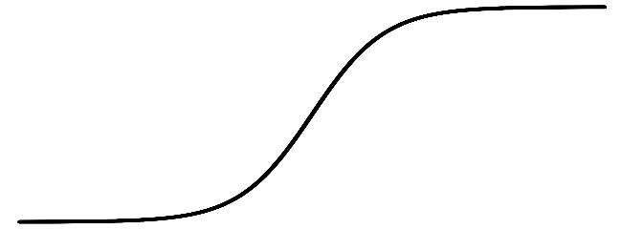
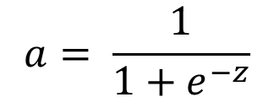
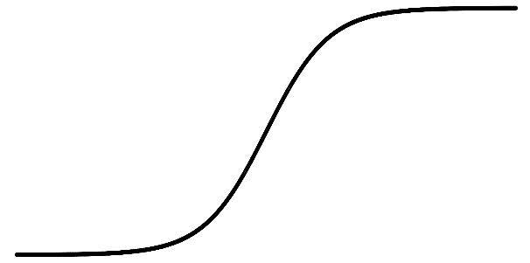
Non-linear activation functions
a
a
z
z
sigmoid:
ReLU: f(z)=max(0,z)
x6 better than sigmoid!
a
a
z
z
Leaky ReLU: f(z)=1(z<0)(αz)+1(z>=0)(z)
tanh(z)

Slide 20
Basic Neural Network Example
w¹
a¹
w²
a²
w³
Softmax
X

Slide 21
Neural Networks! (finally)

Slide 22

Neural network: nature
Human: 100 billion Neurons, 1,000 Trillion Synapses

Slide 23

Neural network: the model
State of the Art ResNet-52: 60 million Synapses.
10^7 difference in synapse count

Slide 24
Neural network: Universality
Universal approximation theorem (Cybenko, 1989):
A feed-forward network with a single hidden layer containing a finite number of neurons can approximate any continuous function (on compact subsets of Rn, under mild assumptions on the activation function, and with no suggestions about actual training procedure).

Slide 25


Neural networks

Slide 26
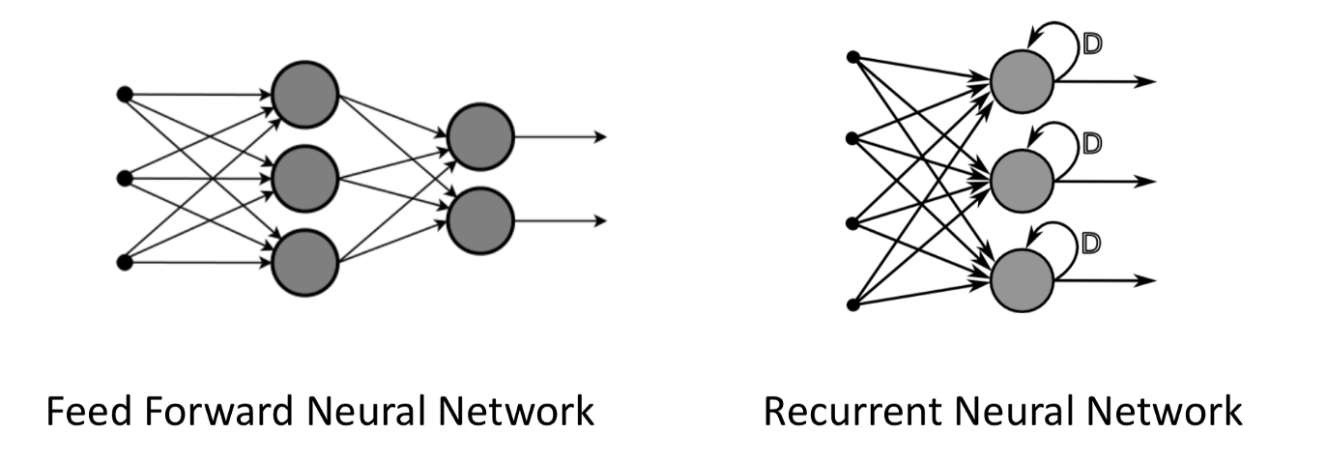
Neural network: architectures
Have state memory => good for time series related data
Good for computer vision!

Slide 27
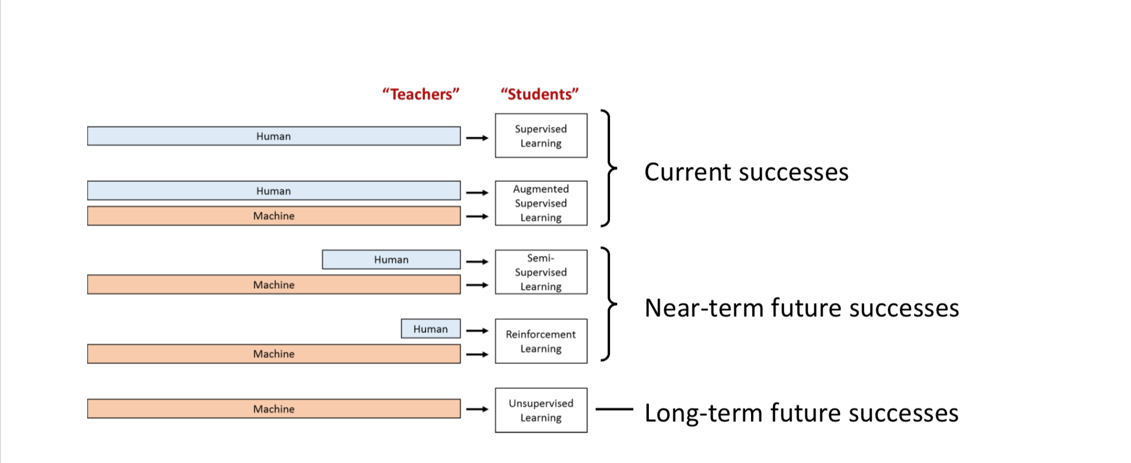
Types of Machine Learning (including NN)

Slide 28
Types of Machine Learning (including NN)
We want to:
move from supervised ‘memorisers’ to unsupervised ‘reasoners’
move from special purpose intelligence to general purpose intelligence (a bit scary!)

Slide 29
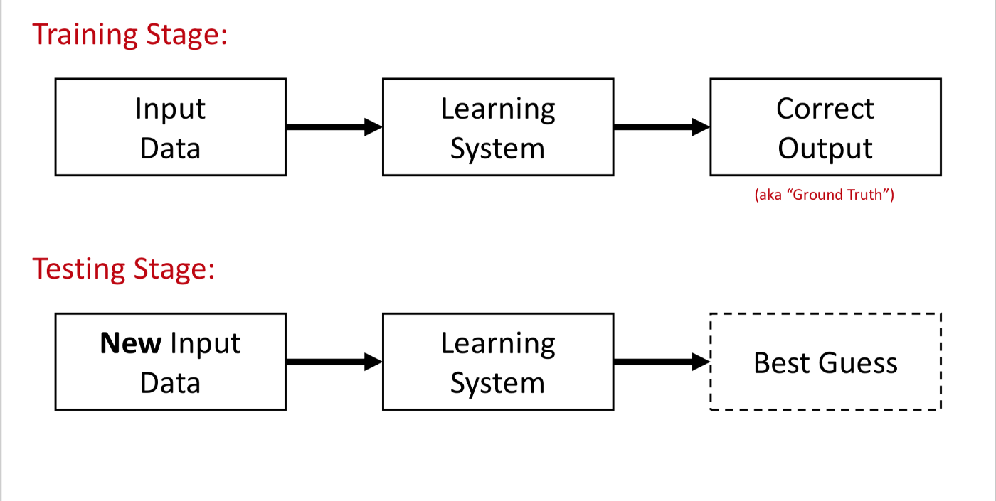
NN Training Procedure: overview

Slide 30
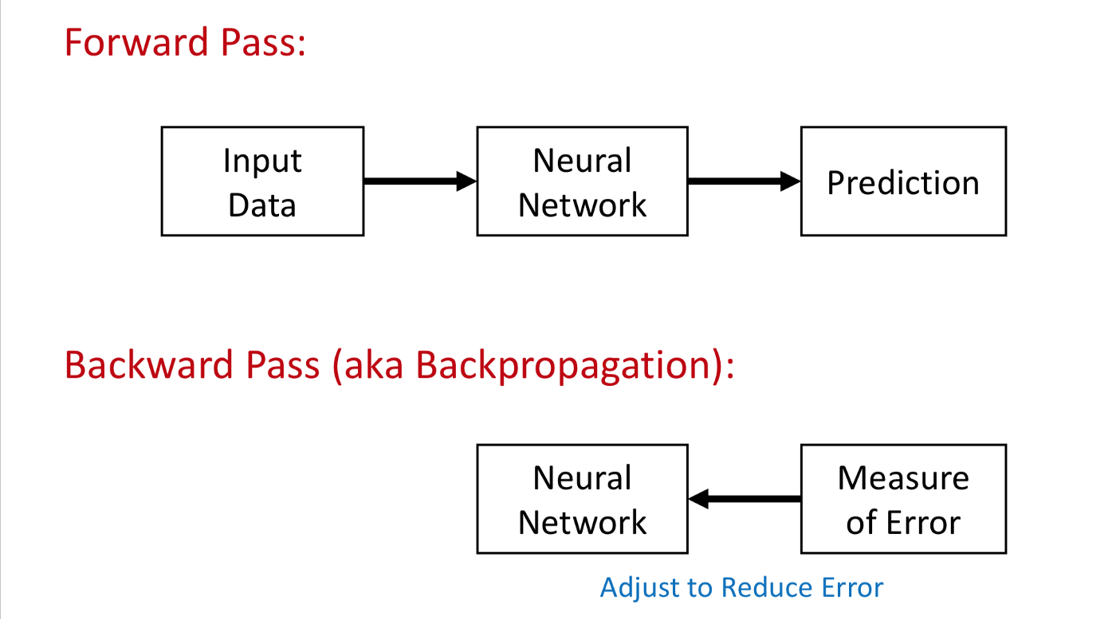
NN Training Procedure: training stage

Slide 31
NN Training Procedure: backpropagation
Steps:
forward pass: to get NN output and compute error
backward pass: to compute gradients
adjusting weights: a fraction of the weight’s gradient (dictated by the learning rate) is subtracted from the weight
process is modular (local to each neuron) which lets us parallelize updates at GPU!

Slide 32
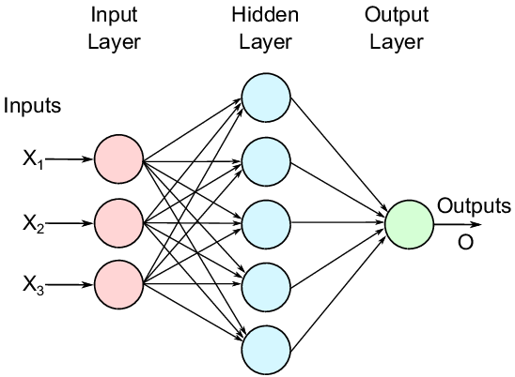
MLP example

Slide 33
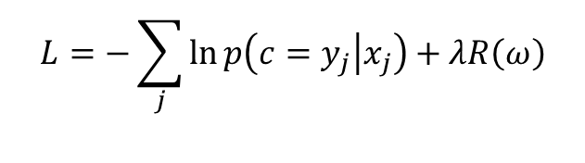
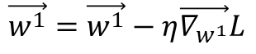
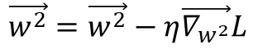
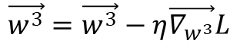

NN Training Procedure
w¹
w²
w³
X

Slide 34












Calculating gradients: Computational graph
Operation nodes
X
ReLU
ReLU
Soft Max
Cross Ent.
w¹
w²
w³
inputs

Slide 35



Calculating gradients: General procedure
x
z
f
y

Slide 36


Calculating gradients: in code
forward
backward

Slide 37

Layer interface
Interfaces for every layer:
x
z
Layer’s f
y

Slide 38




General training procedure
1. take (new) mini-batch of 32/64/128/…
2. forward pass: calculate loss
1
mini-batch
2
k
w¹
w^{N}
Softmax
3. backward pass: calculate gradients for params
5. goto 1
4. update parameters and repeat:

Slide 39
Neural Networks: Practical Considerations

Slide 40




Data preprocessing
1
2
k
http://cs231n.github.io/

Slide 41
NN’s inner workings in detail
Choosing activation function
Weights initialization
Additional layers

Slide 42


Problem: Vanishing gradients
dz/dx ~= 0 !
X = 4
tanh
Z = 1
dL/dz * dz/dx = ?
dL/dz = 1

Slide 43



Rectifier Linear Unit – ReLU
Wikipedia
=> Dying neurons
Rectifier Nonlinearities Improve Neural Network Acoustic Models’13
Fast and Accurate Deep Network Learning by Exponential Linear Units (ELUs)’15

Slide 44
Weight initialization
W = a * random(width, height) - normal, uniform
X
w
w
w
w
w
Layers increase or decrease a exponentially, and we have ~a^{n} near the end of NN => unstable, non-converging
Question: How to choose a so that weights are of ~same scale?

Slide 45
Xavier initialization
a = 1 / sqrt(in_num)
W = a * random(in_num, out_num)
X
w
w
w
w
w
Understanding the difficulty of training deep feedforward neural networks’10

Slide 46
He initialization
a = 1 / sqrt(in_num / 2)
W = a * random(in_num, out_num)
X
w
w
w
w
w
ReLU
Delving Deep into Rectifiers: Surpassing Human-Level Performance on ImageNet Classification’15

Slide 47

Problem: Overfitting

Slide 48

Problem: Overfitting
(What do we already know about fighting o/f?)

Slide 49


Problem: Overfitting - detection
accuracy
test data
train data
Model complexity

Slide 50

Dropout: special regularization case
Drop a coin and kill half of neurons during training!
(or 0.25, or 0.33, and don’t kill but set output to 0)
Inference time: set output to x0.5
(or x0.25, or x0.33)
X
W
ReLU
Dropout
W

Slide 51
So far:
- Activations: start with ReLU
Weight initialization: He initialization
Batch Normalization: yes!
(or)
Dropout: worth trying
Weight penalty regularization (L1, L2)

Slide 52




Update rules: vanilla update vs …
w = w - learning_rate * gradient
Update rules:

Slide 53
Momentum: the physics view
velocity = momentum * velocity - learning_rate * gradient
w = w + velocity
-Gradient is “force”,
affects the velocity
Momentum is “friction”,
try [0.5 0.9 0.95 0.99] during
cross-validations/annealing

Slide 54

Local optima (saddle points)
Deep Learning on Coursera

Slide 55

Adagrad
accumulated += gradient ** 2
adaptive_learning_rate = learning_rate / sqrt(accumulated)
w = w - adaptive_learning_rate * gradient
Accumulate gradient**2 in all dimensions, use adaptive learning rate to escape saddle points.
Problem: slows down with time
(because accumulator grows).
Adaptive Subgradient Methods for Online Learning and Stochastic Optimization’11

Slide 56
RMSProp: adagrad with decay
accumulated = rho * accumulated + (1-rho) * gradient ** 2
adaptive_learning_rate = learning_rate / sqrt(accumulated)
w = w - adaptive_learning_rate * gradient
Decay:
rho = [0.9 0.99 …]
Neural Networks for Machine Learning, Lecture 6.5 – rmsprop’12
Adam: everything together – the best one!
1) velocity = beta1 * velocity+ (1-beta1) * gradient
2) accumulated = beta2 * accumulated + (1-beta2) * gradient ** 2
adaptive_learning_rate = learning_rate / sqrt(accumulated)
w = w - adaptive_learning_rate * velocity
Adam: A Method for Stochastic Optimization’14

Slide 57


General training procedure
1. take (new) mini-batch of 32/64/128/…
2. forward pass – calculate loss
1
mini-batch
2
k
w¹
w^{N}
Softmax
3. backward pass – calculate gradients for params
4. update parameters and repeat:

Slide 58
Overfit small set of data
mini-batch
N = 10
1
2
k
w¹
w^{N}
Softmax
Doesn’t work? Look for bugs or try other approaches.

Slide 59


Learning rate
http://cs231n.github.io/neural-networks-3/
lossfunctions.tumblr.com

Slide 60

Check your accuracy plots
A bit of overfitting is ok!
Val_acc = train_acc means we have model with very low capacity
http://cs231n.github.io/neural-networks-3/

Slide 61
Hyperparameter search
train
validation
Starting learning rate
Annealing coeffs.
L2 regularization coeffs.
Batch size
Dropout percentage
….
Use cross-validation?

Slide 62

Hyperparameter search
Starting learning rate
Annealing coeffs.
L2 regularization coeffs.
Batch size
Dropout percentage
….
train
validation
1 fold
Random Search for Hyper-Parameter Optimization’11

Slide 63
Hyperparameter search
Going through hyperparams:
Coarse to fine: large scale first, fine scale later
In log-space
Jump over range borders
Starting learning rate
Annealing coeffs.
L2 regularization coeffs.
Batch size
Dropout percentage
….
lr = random(10, 10000) bad!
lr = 10**random(1,4) good!

Slide 64
Model ensemble (hello Kaggle!)
Average
^{+ x% to accuracy}
w¹
w^{N}
Softmax

Slide 65
The tricks to start with:
Preprocessing: subtract mean from data
Activations: start with ReLU
Weight initialization: He initialization
Use Batch Normalization
Use Adam update rule optimizer
Learning rate annealing
Search for good hyperparameters efficiently
Monitor loss, training/validation accuracy (and update magnitudes)
Use other models (transfer learning)…

Slide 66
Another summer for NNs and DL?
Why are we here again?
Compute power increased: hello Moore’s law for CPU, GPU, ASICs
Large datasets available: ImageNet (14M images, 22K categories), others
New algorithms/research: backprop, CNNs, LSTMs, etc
Software and infrastructure: code sharing, libs/frameworks - Pytorch, Tensorflow, accessible cloud computing, etc
Financial backing of large companies: Google, FB, Amazon, Microsoft, (China)

Slide 67

NNs advancements in Computer Vision
Task of object recognition (and CV in general) is hard:
illumination, pose and perspective variability
occlusions
intra- and inter-class variability…

Slide 68
NNs advancements in Computer Vision
ILSVRC large scale visual recognition challenge (now on Kaggle):
ImageNet dataset: 14M+ categories with 21.8k+ Categories
5 guesses to get a correct label for an image
Progress:
dominated by NNs (AlexNet 2012, VGGNet 2014, GoogLeNet 2014, ResNet-152 2015 - surpassed human error (5.1%), CUImage 2016, Squeeze-and-Excitation Networks 2017)
AlexNet - first CNN: 8 layers, 15.4% >>> ResNet: 152 layers, 3.57% error >> SENet 2.25% error
You probably were attending university when this DL+CV revolution happened!
(more on CNNs in the next lecture)

Slide 69
NN applications in computer vision
Classification
Image and video captioning # Recurrent NNs
Localization # Yolo
Segmentation (assigning category for every pixel) # fully conv. NNs
Image-to-image mapping e.g. colorization
Object Detection - proposing regions for objects # Fast/R-CNNs
Scene understanding
Photorealistic images generation - for data augmentation # GANs
Style transfer # CNNs
Background removal # anybody wants to build a startup?

Slide 70

NN applications in computer vision
Classification # CNNs

Slide 71

NN applications in computer vision
Segmentation (assigning category for every pixel) # fully conv. NNs

Slide 72

NN applications in computer vision
Colorization

Slide 73

NN applications in computer vision
Style transfer # CNNs

Slide 74
Drawbacks and challenges of NNs and DL
Transfer learning: how to learn to reason, to ‘move’ understanding from domain to domain?
NN Need A LOT of data. Human can learn much faster and with less input.
DL Requires supervised learning with labelled data – costly!
Not fully automated, needs hyperparameters tuning: learning rate, loss functions, mini-batch size, optimizer selection, etc.
Defining a loss/reward function is hard but very important (self driving cars).
Transparency: NN are black boxes, visualizations are hard to interpret.
Edge cases: DL is notoriously bad in dealing with edge cases which are very rare (no data) but very important (self driving cars)

Slide 75
Final thoughts
Should you study Neural Networks?
Yes or No

Slide 76
Final thoughts
Should you study Neural Networks?
Yes or Yes
:D

Slide 77
Fun stuff
AlhpaGo Zero (2017) beat earlier AlphaGo-es (2016) by almost learning by itself and playing against itself; didn’t know anything about the game; no knowledge from experts, no training data
2017 DeepStack beat professional poker players in heads-up
Google trends: compare DL with ML, AI; regional interest; python in related topics
Playground.tensorflow.org
(it is supposed that) Boston Dynamics doesn’t use any ML, but imagine if they start to!

